Slide 1
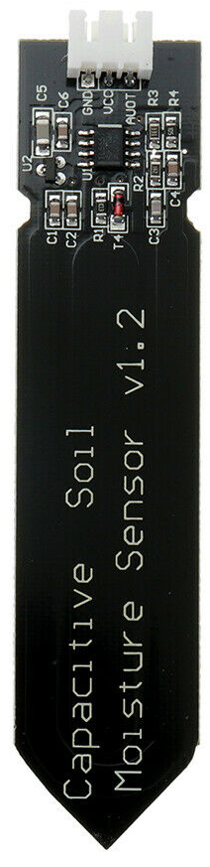
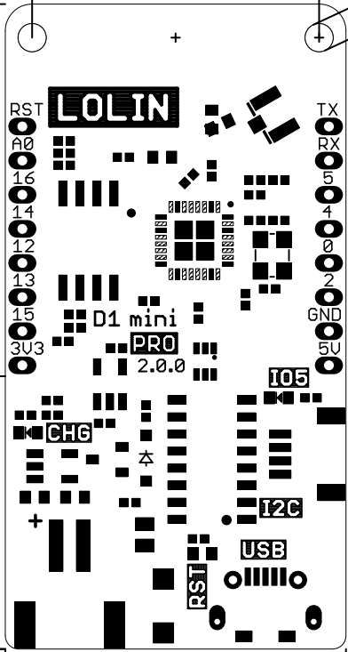
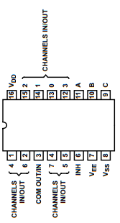
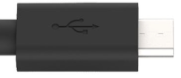
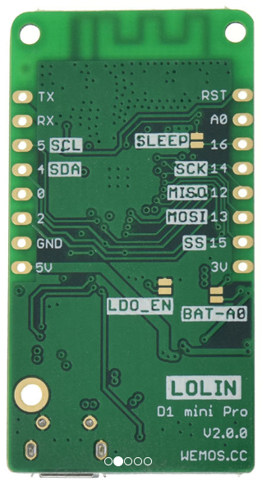
Soil moisture sensor
CD4051 Multiplexer
charger
Wemos d1 mini pro v2
Connect
deep sleep pins
at back
GND
VCC
Multiplexer channels
Channel select

Slide 2


Soil moisture sensor
JST PH
CD4051 Multiplexer
Solar panel
Wemos d1 mini pro v2
Connect analog output of charging module
Parallel 18650 batteries for double capacity
Connect
deep sleep pins
at back
GND
VCC
Multiplexer channels
Channel select

